Slide 1
PROJECT REPORT
SATELLITE IMAGE ANALYSIS

Slide 2
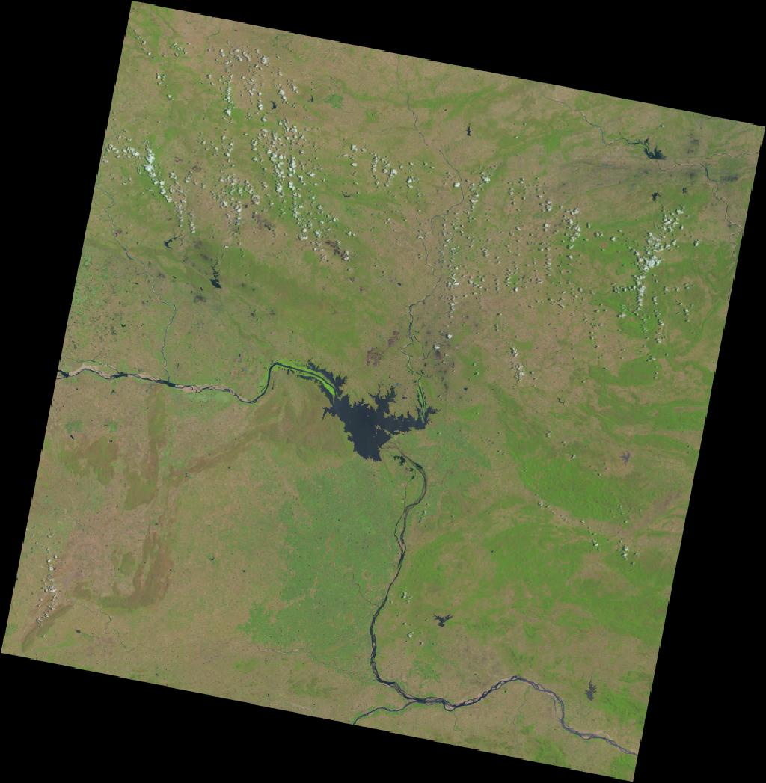
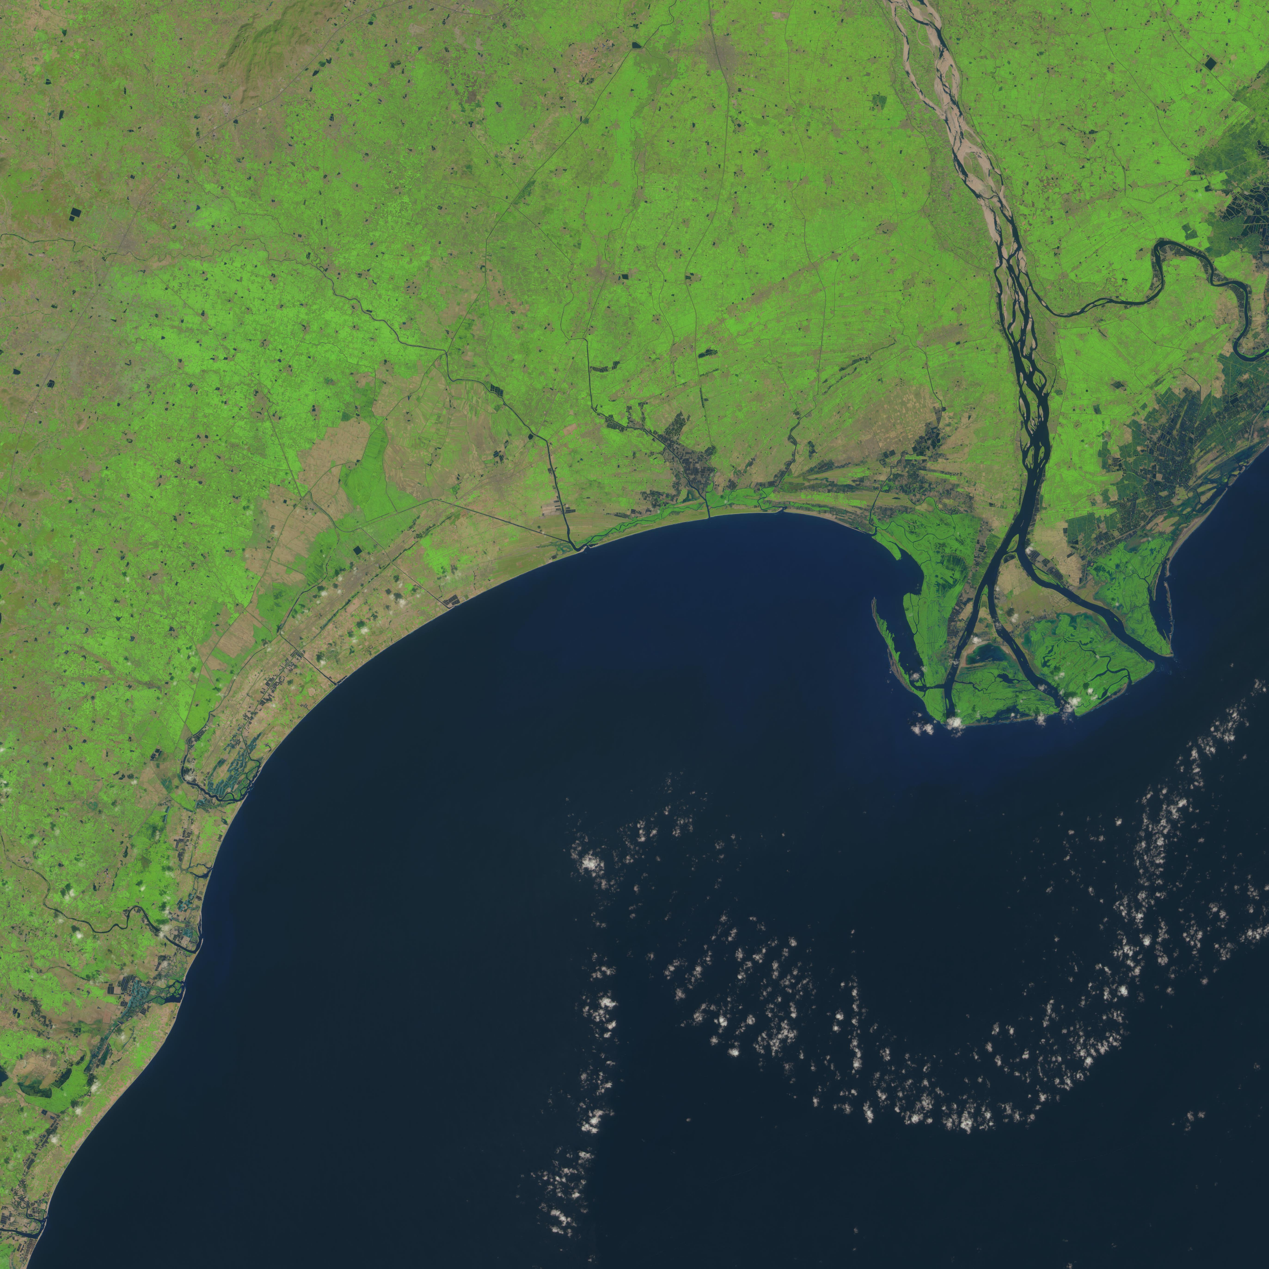
ABSTRACT
Regions chosen for analysis
Hirakud Reservoir
Krishna Delta
Krishna Delta
Hirakud Reservoir

Slide 3

Bands Used
Band3 - green (0.53 – 0.59)
Band5 - NIR (0.85 – 0.88)
Band6 - SWIR1 (1.57 – 1.65)
Band7 – SWIR2 (2.11 - 2.29)
SWIR1 - Discriminates moisture content of soil and vegetation; penetrates thin clouds
SWIR2 - Improved moisture content of soil and vegetation; penetrates thin clouds

Slide 4
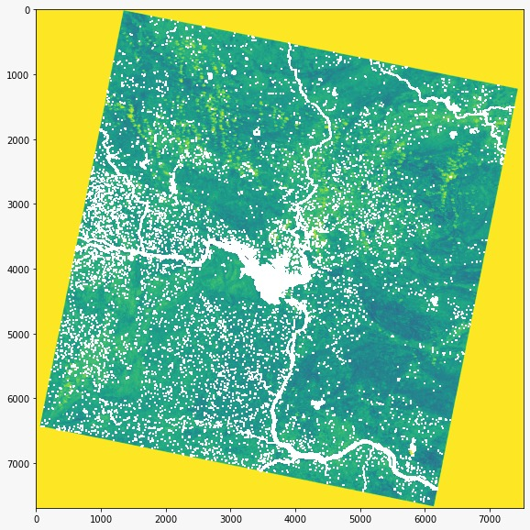
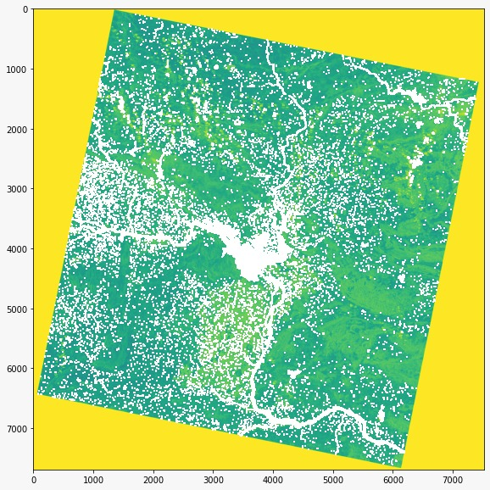
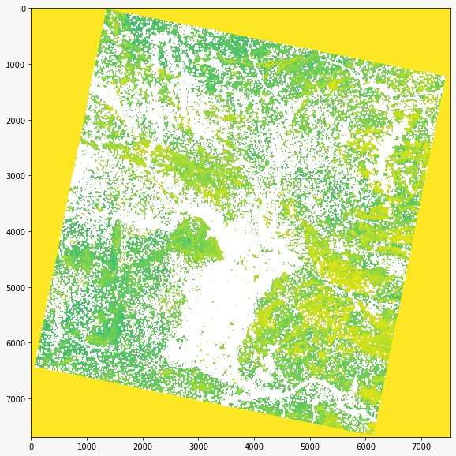
RESULTS
Results on Hirakud Reservoir :
NIR band
SWIR1 band
SWIR2 band

Slide 5
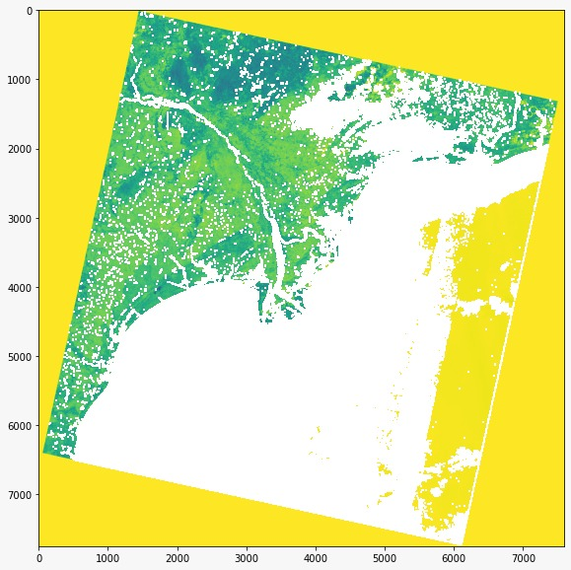
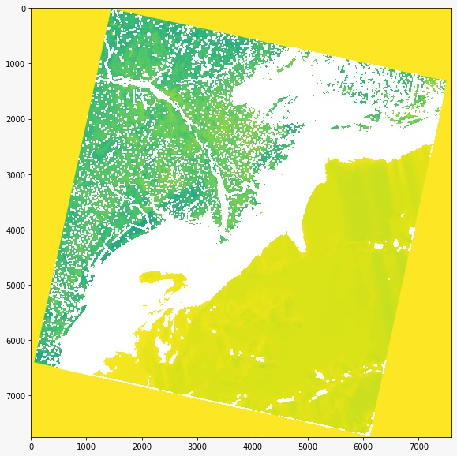
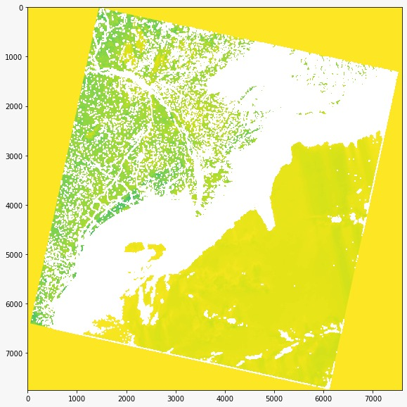
Results on Krishna Delta :
NIR band
SWIR1 band
SWIR2 band

Slide 6

INFERENCE
For Krishna Delta

Slide 7

For Hirakud Reservoir

Slide 8
THANK YOU

